Slide 1
Policy instruments to promote nutrient recycling
09 June 2025 | Sari Luostarinen
Natural Resources Institute Finland

Slide 2
Reasons for promoting nutrient recycling in Finland
Reduced use of natural resources = resource efficiency
Reduced nutrient losses into air, soil and waters
Recycling of organic matter
Improved security of supply and self-sufficiency

Slide 3
Status of nutrient recycling in Finland
Despite many measures to promote nutrient recycling, its implementation is progressing slower than desired and the use of recycled nutrient products is low
Need to
  Enhance manure use and reallocation
  Advance the processing technologies used
  Support the build-up of a functioning market for the end-products

Slide 4
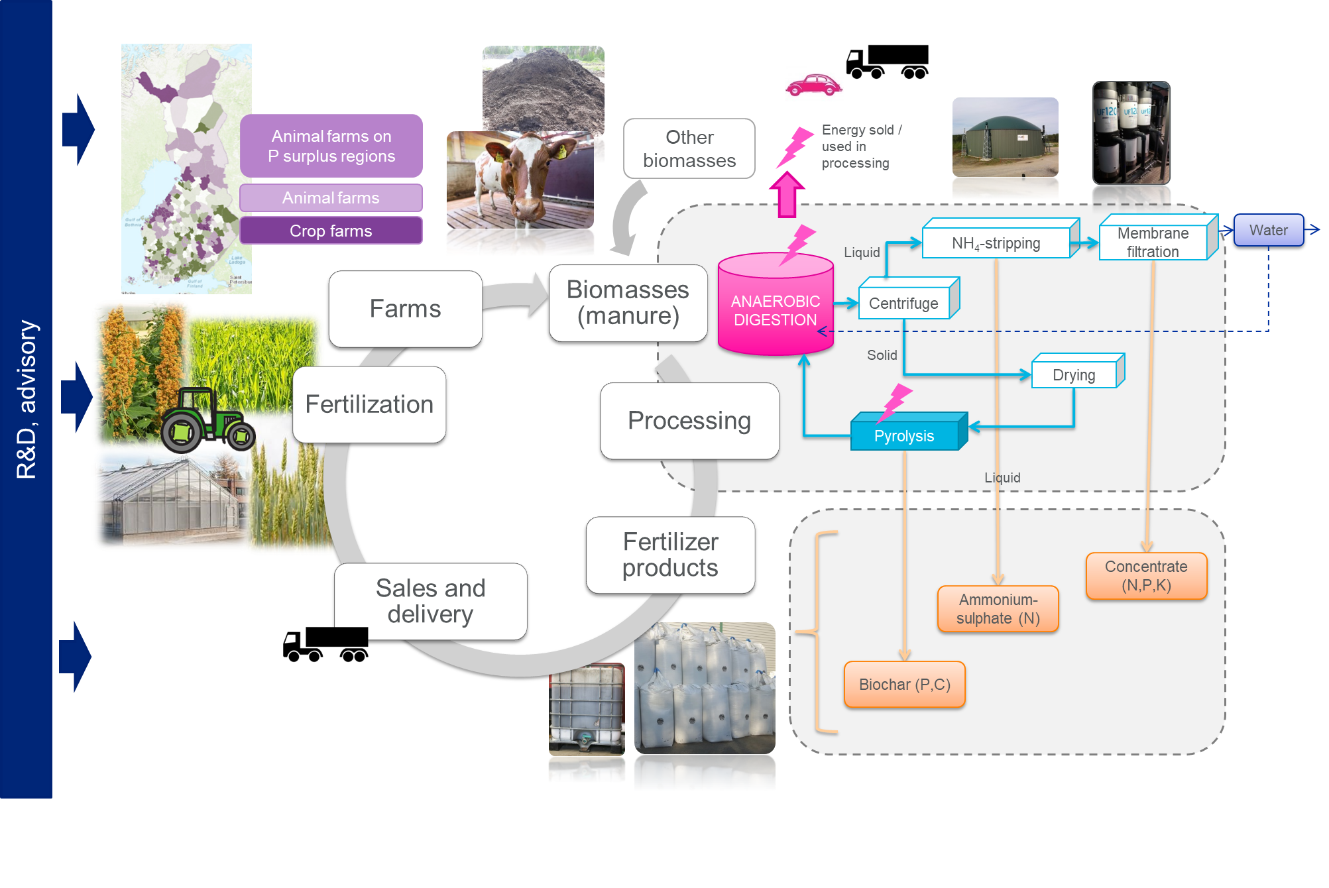
Previous study into policy measures to promote nutrient recycling in 2018
Luostarinen et al. 2019: http://urn.fi/URN:ISBN:978-952-453-941-8

Slide 5
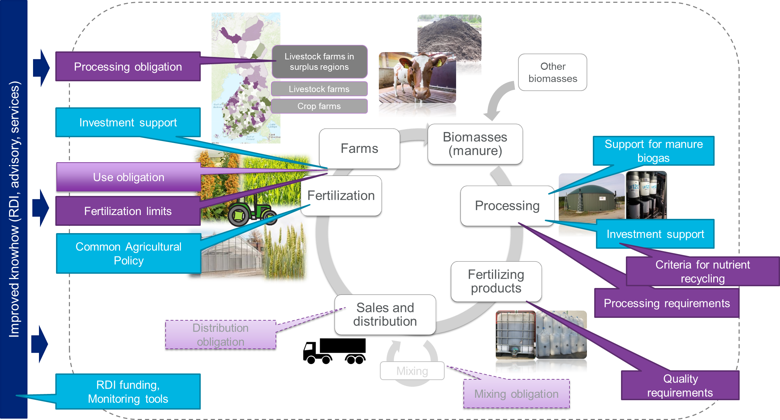
Measures identified in 2018
Luostarinen et al. 2019: http://urn.fi/URN:ISBN:978-952-453-941-8

Slide 6
Measures currently available (green circles)
Luostarinen et al. 2019: http://urn.fi/URN:ISBN:978-952-453-941-8

Slide 7
New project starting to study what still could and should be done
The aim: to study how potential new measures and existing measures could form an effective whole to promote nutrient recycling over sectoral boundaries
Acknowledgement: several changes are needed to enable a systemic change

Slide 8
Policy measures to be studied (at least)
Economic measures
  Distribution obligation and/or required minimum recycled content in fertilizing products
  Taxation
  Impact-based funding
  Nutrient recycling support
  CAP (ecosystem support)
  Investment support
Environmental permitting
  Esp. permitting of large processing facilities and requirements for ensuring sustainable use of end-products
Quality control
  End-of-waste criteria
  Fertilizing product regulation
  Quality systems

Slide 9
Project information
Coordinator: Natural Resources Institute Finland Luke
  Partner: Finnish Environment Institute Syke
Duration: 1.9.2025-30.6.2026
Steering group: participants from Ministry of the Environment (chair) and Ministry of Agriculture and Forestry
Funding from VN Tutkiva (Research activities supporting the Government's decision-making)

Slide 10


Thank you!
Inquiries:
sari.luostarinen@luke.fi

